Slide 1
D49 Superheroes
What’s your superpower?

Slide 2
My Superpower is Juggling oranges during mental health sessions.
I like that D49 is a supportive team that is focused on collaboration and problem-solving; beautiful location (sunny most of the year!); Working with dedicated staff members; FALL BREAK (2 weeks in October is luxurious) and 2 weeks for Spring Break; All the Professional Development both provided by the district and scheduled in for the trainings of your choosing
Reno Owens
University of Northern Colorado, Ed. S.

Slide 3
My Superpower is..
Staying calm during meetings? Managing timelines? Staying out of school drama?
Things I like about D49..
My supervisor, her support, and the location in Colorado Springs.
Bradley Dunagan
Towson University (MD), Masters in School Psych and CAS/Certificate of Advanced Study

Slide 4
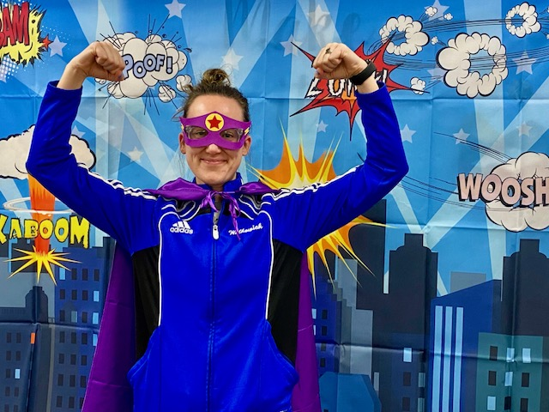
My Superpower Is..
I am great at collaborating with team members and teaching general education teachers new skills and scheduling/completing lots of evals (currently am handling about 20 at once!)
Danielle Walkowiak
Loyola University Chicago- M.Ed, Ed.S

