Slide 1
SAND CREEK HIGH SCHOOL
WELCOME TO THE 2022-2023 SCHOOL YEAR
Notes:
Welcome to Sand Creek High School or welcome back. We are excited about the 20-21 school year. We may be doing things a little differently. But together we are going to make it a great year

Slide 2
OUR MISSION:
AS THE STUDENTS, EDUCATORS AND PARENTS OF THE SAND CREEK INNOVATION ZONE, OUR MISSION IS TO INSPIRE CARING, COMPETENT, CRITICAL THINKERS WHO ARE WELL-PREPARED, PRODUCTIVE CITIZENS IN A GLOBAL SOCIETY.
Notes:
As the students, educators, and parents of the Sand Creek Innovation Zone, our mission is to inspire caring, competent, critical thinkers who are well-prepared, productive citizens in a global society. This is something that we as a school believe, and know that the adults who work in this building care about you and are here to help you on your journey through high school and on to your eventual next steps.

Slide 3
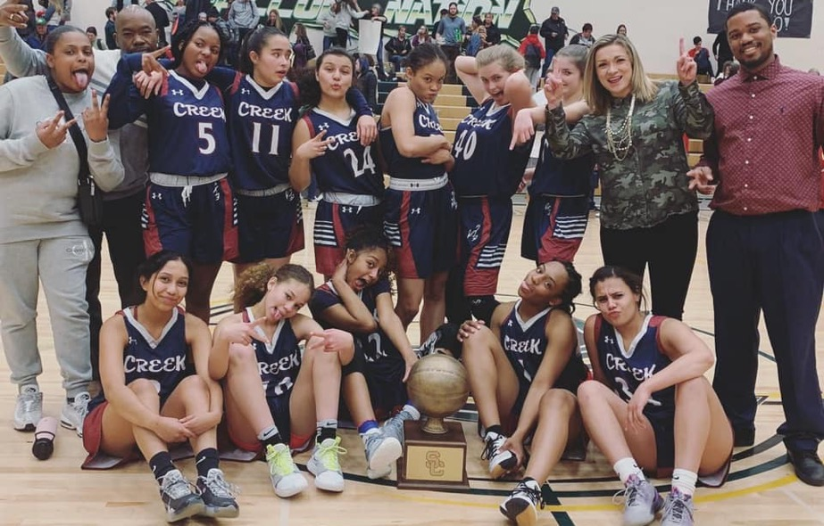
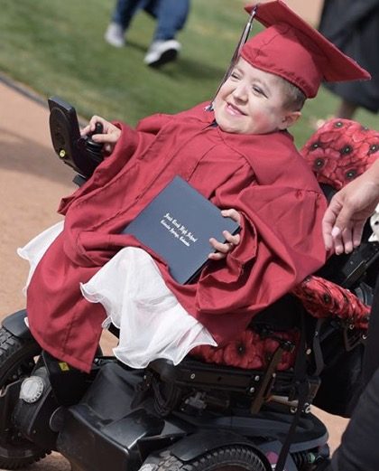
WE STAY COMMITTED
Notes:
Last year the student leaders of Sand Creek High School came together to develop a motto that they created and they could embrace. They want you to know that We Stay Committed. We stay committed to Aademics, We stay committed to Extracurricular Activities, We stay Committed to being students of Respect, Responsibility and Integrity.

Slide 4
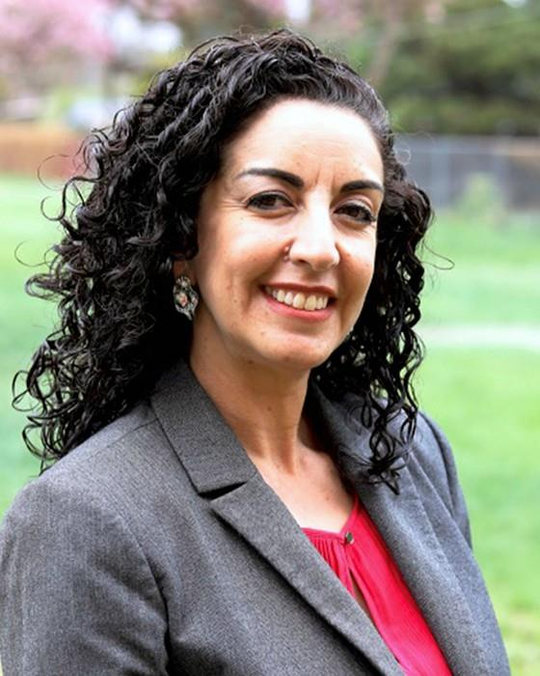
SCHS ADMINISTRATION
Campus Director/Principal: Amy Sanchez-Martinez
Notes:
The school leadership of Sand Creek includes Ms. Lane, the Campus Director, Mr. Petzold, the Associate Principal and Athletic Director, Mr. Carroll the Assistant Principal, Mr. Sory, the Dean of Students and Ms. Sides the Dean of Advanced and Applied Learning. All of our administration are here to help you and you should feel comfortable coming to talk with them about any issues that you may be having.

Slide 5
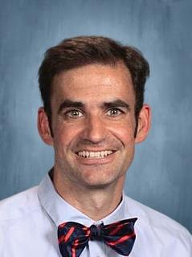
SCHS ADMINISTRATION
Assistant Principal: Lance Carroll
Notes:
The school leadership of Sand Creek includes Ms. Lane, the Campus Director, Mr. Petzold, the Associate Principal and Athletic Director, Mr. Carroll the Assistant Principal, Mr. Sory, the Dean of Students and Ms. Sides the Dean of Advanced and Applied Learning. All of our administration are here to help you and you should feel comfortable coming to talk with them about any issues that you may be having.

Slide 6
SCHS ADMINISTRATION
Assistant Principal: Courtney Harrell
Notes:
The school leadership of Sand Creek includes Ms. Lane, the Campus Director, Mr. Petzold, the Associate Principal and Athletic Director, Mr. Carroll the Assistant Principal, Mr. Sory, the Dean of Students and Ms. Sides the Dean of Advanced and Applied Learning. All of our administration are here to help you and you should feel comfortable coming to talk with them about any issues that you may be having.

Slide 7
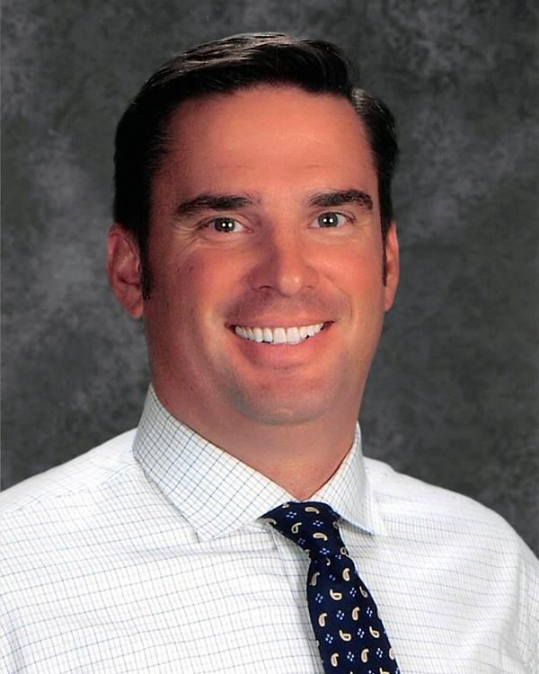
SCHS ADMINISTRATION
Athletic Director: Jared Welch
Notes:
The school leadership of Sand Creek includes Ms. Lane, the Campus Director, Mr. Petzold, the Associate Principal and Athletic Director, Mr. Carroll the Assistant Principal, Mr. Sory, the Dean of Students and Ms. Sides the Dean of Advanced and Applied Learning. All of our administration are here to help you and you should feel comfortable coming to talk with them about any issues that you may be having.

Slide 8
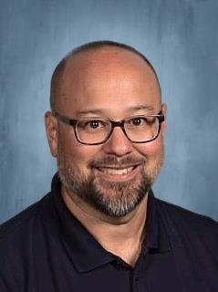
SCHS ADMINISTRATION
Dean of Students: Mike Sory
Notes:
The school leadership of Sand Creek includes Ms. Lane, the Campus Director, Mr. Petzold, the Associate Principal and Athletic Director, Mr. Carroll the Assistant Principal, Mr. Sory, the Dean of Students and Ms. Sides the Dean of Advanced and Applied Learning. All of our administration are here to help you and you should feel comfortable coming to talk with them about any issues that you may be having.

Slide 9
SCHOOL RESOURCE OFFICER
Officer
Dean Baird
Notes:
Officer Baird is joining us this year as our School Resource Officer. Say hi to him/her when you see him/her in the hallway. He is excited about getting to meet all of you and to help you whenever you are having issues.

Slide 10
GET CONNECTED
Sand Creek High School
@SandCreekScorps
@SCScorpions1
@SandCreekZone
Notes:
One way to make sure that you are successful is to know what is going on. If you have access to social media please download the D49 app by searching for Colorado School District 49 and indicating that you want Sand Creek updates. Allow notifications with this app and you should always be up to date on Sand Creek happenings. You can also like Sand Creek High School on Facebook and you can follow us on one of our twitter accounts listed here.

Slide 11
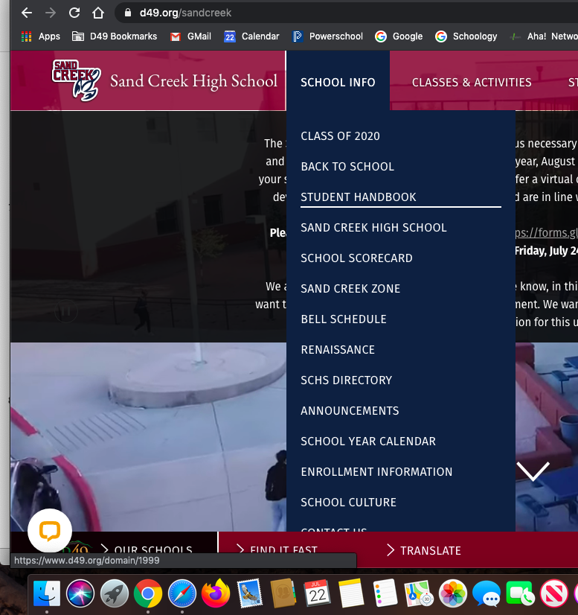
STUDENT HANDBOOK
Notes:
Now let’s talk about some of the rules that you will need to know about in order to do well. Know that the student handbook can be found by going to the Sand Creek web page and clicking under School Info and then Student handbook. We won’t have time to talk about all the rules, so please look through the handbook when you have time. Not knowing about a rule is not an acceptable excuse for breaking it.

Slide 12
STARTING THE DAY
YOU MUST ENTER THROUGH THE FRONT DOOR (AND BACK DOOR BEFORE SCHOOL)
YOU ARE REQUIRED TO HAVE YOUR ID BADGE AT ALL TIMES, $5 TO REPLACE
NEVER OPEN A DOOR TO LET SOMEONE IN THE BUILDING
Notes:
At the beginning of the school day, you may enter through the front door or the back door. For the rest of the day, you may only enter through the front door. Students must have an ID badge with them at all times and must show their ID in order to enter the school. Students without an ID, will need to report to the office to get a temporary ID. A replacement ID will cost $5. Don’t forget that IDs will still be needed for sporting events, dances etc. Please do not ever open a door to allow a student into the school. We have great kids at Sand Creek and it is hard for them to say no when they see someone knocking at a door. But every person entering the school must go through a security checkpoint to get in. You will receive detention for letting someone in the building. It’s best just to redirect them to the front entrance.

Slide 13
ATTENDANCE
SHOWING UP TO CLASS, INCLUDING ONLINE, IS VITAL TO SUCCESS
15 MINUTES LATE TO CLASS WILL COUNT AS AN UNEXCUSED ABSENCE
PARENTS/GUARDIANS MUST CONTACT THE SCHOOL WHENEVER THERE IS AN ABSENCE.
Notes:
There is an old saying that 90% of life is just showing up. And studies consistently prove that showing up to class leads to academic success and even a few absences from class can lead to academic struggles. We expect students to be in their class, on time every day. Showing up 15 or more minutes late to a class will lead to an unexcused absence. If you are unable to come to school, please remind your parents to call in or email on the same day in order to excuse you.

Slide 14
TARDIES
5 TARDIES IN A SEMESTER = DETENTION
10 TARDIES IN A SEMESTER = ANOTHER DETENTION
25 TARDIES IN A SEMESTER = IN-SCHOOL SUSPENSION
EACH ADDITIONAL 10 TARDIES = IN-SCHOOL SUSPENSION
Notes:
You are expected to be in class, on time every period. We do NOT have a very large building and one can easily walk from one end of the building and back again in under five minutes. Students will receive a detention when they accumulate 5 tardies and again when they accumulate 10 tardies. Once a student has accumulated 15 tardies in a semester, they will begin serving In-School Suspension. Being on time is a way to show respect to your teachers and fellow students and to indicate that you care about your own education, so please make being on time an important principle that you value.

Slide 15
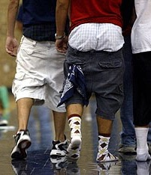
DRESS APPROPRIATELY
Not
Like
This!
Notes:
In regards to the dress code we primarily need two things, coverage and appropriateness. Clothing should not have vulgar language, sexual imagery or promote drugs, alcohol, tobacco or other controlled substances. Tops should cover your chest, your back and your stomach. If you choose not to wear sleeves, straps should be at least 1 and a half inches wide. Shorts and pants should reach the mid-thigh. Please don’t show us your underwear—this includes shirts that expose your bra, or pants that sag below the waist. Bandannas are not allowed to be worn in school, including hanging from a pocket. Hats ARE allowed at Sand Creek. However, hats must be worn forward or backward, they can not be cocked sideways.. Please understand that our intention is never to shame you or embarrass you or judge your clothing choices. If you violate the dress code, you will be sent to the office to correct the issue. There will be disciplinary consequences if you intentionally violate the dress code several times.

Slide 16
GANG-RELATED ACTIVITY
Gang Related activity and cloting will not be tolerated before, during or after-school.
Students will face consequences and Law Enforcement will be involved
WEAPONS
Any weapon brought to school could lead to suspension or expulsion
This includes pocket knives, weapon facsimiles or toys designed to look like toys
If you accidentally bring something to school, notify an adult immediately
Notes:
Gang-related behavior and clothing will not be tolerated at Sand Creek during school or after-school activities. Students will face consequences including involvement of law enforcement. Weapons of any sort brought to school will also result in immediate consequences, including weapon facsimiles or toys designed to look like weapons. If you accidentally bring something to school like a pocket knife, notify an adult immediately and we will be able to deal with the situation on a case-by-case basis rather than going directly to suspension and possible expulsion.

Slide 17
LANGUAGE
&#$%@!!!
Use respectful language
If a staff member discusses your language with you, respond respectfully
Notes:
Please use school-appropriate language while at school. Be respectful of your teachers, staff and fellow students. While we understand that sometimes inappropriate language might slip out, it is important that you respond respectfully when a staff member discusses it with you.

Slide 18
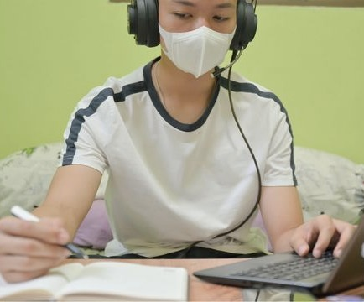
CELL PHONES/ELECTRONICS
Electronics are privilege not a right
Do not use them in the classroom without permission
Your phone may be confiscated if used inappropriately
SCHS is not responsible for investigating theft reports of electronics
Notes:
Cell phones and electronic devices are allowed at Sand Creek, but they are a privilege and not a right. You may use your cell phone before and after school, during lunch and passing periods as long as it doesn’t become a disruption. In the classroom, you must get teacher permission to use your electronic device. Your cellphone may be confiscated and you may face additional consequences for using your device without permission or refusing to relinquish your phone when requested. Please be smart about taking care of your personal property. Sand Creek High School will not be responsible for investigating theft or damage of electronic devices such as cell phones or ear buds.

Slide 19
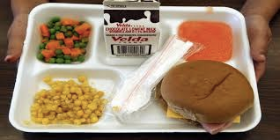
LUNCH
Juniors and Seniors may leave campus
Deliveries are not allowed, unless brought by a parent
Eating outside is a privilege, keep the patio area and all outside areas clean
Prices:
Breakfast: $2.75
Lunch: $4.35
Notes:
During lunch, Juniors and Seniors with parent permission may leave campus. Students remaining on campus must eat lunch in their 3C or 7N classroom sitting at a desk. Students who bring their lunch should head directly to class. For students eating cafeteria food, they may go to the cafeteria and purchase a meal while maintaining six feet of social distancing while in line and then returning to their classroom. There will be no Microwaves available this year, please plan accordingly when packing your lunch.

Slide 20
DRUGS, ALCOHOL, TOBACCO, VAPE
ZERO TOLERANCE FOR DRUGS AND ALCOHOL = SUSPENSION OR EXPULSION DEPENDING ON THE SEVERITY
ZERO TOLERANCE FOR TOBACCO OR VAPING = 1ST OFFENSE ISS PLUS ENROLLMENT IN TOBACCO/VAPING AWARENESS CLASS, 2ND OFFENSE = SUSPENSION, 3RD OFFENSE = POSSIBLE EXPULSION
PRESCRIPTION/OTC MEDICINE – ONLY BRING A DAILY DOSE
Notes:
More serious violations at school include involvement with any types of drugs, alcohol, tobacco or vaping. We have zero tolerance for possession, use, distribution, or being under the influence of drugs or alcohol at Sand Creek High School. Students will be immediately suspended or expelled depending on the severity or frequency of the incident and ticketed by law enforcement. We also prohibit the possession, use and distribution of any tobacco or vaping paraphernalia at school. A first offense will serve in-school suspension and require a mandatory tobacco and vape awareness class. Further offenses will result in suspension or expulsion. We can’t emphasize this enough-–don’t bring it to school, don’t use it at school, don’t be under the influence at school. If you need prescription medicine or and over-the-counter drug such as ibuprofen or Tylenol, you should bring one day’s supply. Do not bring the entire bottle to school.

Slide 21
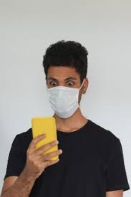
BULLYING AND HARASSMENT
BULLYING AND HARASSMENT IS UNACCEPTABLE AT SAND CREEK HIGH SCHOOL
BE KIND
Notes:
We are proud of the diverse place that Sand Creek High School is and consider it one of our strengths. We come from different families and different backgrounds. We look different, we dress differently, we speak differently, we like different music, we like different people. We all have different challenges but we are all in this together. Live and let live and be kind to your fellow students.

Slide 22
BULLYING AND HARASSMENT
REPORT HARASSMENT TO A STAFF MEMBER OR USE SAFE2TELL
SEEK TO RESOLVE CONFLICTS, NOT GET INTO AN INSULT WAR
Notes:
Know that we take bullying and harassment of all kinds at Sand Creek very serious. If you see, hear or experience bullying or harassment, please report it to an adult in the building immediately. You can also report anonymously by visiting Safe2tell.org or calling 1-877-542-7233. Harassment can be verbal or physical, direct or indirect, and through social media. Social Media is the most frequent place where harassment occurs in high school today. Remember that getting in an online altercation is never a good idea. If someone says something about you online, we recommend cutting off communication with that person and reporting them if the harassment continues or reaching out to a counselor or administrator to help you resolve the situation. Also know that bullying or harassment that occurs away from school between two or more Sand Creek students can still be considered a school issue.

Slide 23
FIGHTING
FIGHTING IS PROHIBITED AND IS A SERIOUS OFFENSE
COULD RESULT IN SUSPENSION OR EXPULSION AND TICKET FROM LAW ENFORCEMENT DEPENDING ON THE SEVERITY
REGARDLESS OF WHO STARTS THE FIGHT, IF YOU PARTICIPATED IN ESCALATING BEHAVIORS BEFORE THE FIGHT, YOU WILL BOTH HAVE CONSEQUENCES.
Notes:
Fighting at Sand Creek is prohibited and considered a serious offense. Those who fight will be suspended and ticketed by law enforcement based on the severity of the incident. Know that at Sand Creek, both participants in a fight will face consequences. If you can prove that you were the victim of an unprovoked assault, that is different. However, that is almost never the case. If someone comes up to you and hits you and our investigation shows that there was a back-and-forth harassment on social media prior to the incident, then you were part of an altercation that led to a fight. If someone is harassing you online, you are expected to report it, not “clap-back” and provoke a further escalation of tensions.

Slide 24
RESTORATIVE PRACTICES
RESOLVE CONFLICTS WITH OTHER STUDENTS
RESOLVE CONFLICTS WITH A TEACHER
FOCUS ON DEVELOPING THE SKILLS TO DE-ESCALATE SITUATIONS
Notes:
We have been talking about harassment and bullying and fighting. We know that in high school you are surrounded by many personalities and conflicts with others are common. However, the administrators at this school don’t believe in just telling you the rules and punishing anyone who breaks them. We also believe in something we call Restorative Practices. We want you to come to us when conflict begins rather than when it turns into a fight. If you are having a conflict with another student, please come to us to help mediate the situation. This is not “snitching” because students will not get in trouble for trying to resolve the conflict before it turns into a fight. As a high school student, you are not expected to have all the tools to de-escalate conflict and we want to help you develop them.

Slide 25
CLUBS
eSports
KPOP Dance Team
Engineering Club
Cyber Patriot
Gay Straight Trans Alliance
Health and Wellness Club
International Club
JOII Club
Knowledge Bowl
Mock Trial
Link Crew
National Art Honor Society
National Honor Society
Stellar Xplorers
The Care Energy Club
Ultimate Frisbee
Notes:
We have numerous clubs you can join as well. Some of these clubs ask that you commit a great deal of time and energy and get involved in competitions and some of these clubs are much less formal. Find a place that you can fit in. Although most club activities are temporarily suspended due to the coronavirus, keep on the lookout to see when they resume.

Slide 26
HOW TO START A NEW CLUB
GET A TEACHER TO SPONSOR THE CLUB
SEE MR. WELCH TO COMPLETE THE PAPERWORK
Notes:
Is there a club you are interested in starting. Find a teacher to sponsor the club and see Mr. Petzold to complete the necessary paperwork.

Slide 27
ATHLETICS
Spring Sports
Baseball
Track
Girls Tennis
Girls Volleyball
Girls Soccer
Girls Golf
Year round
Cheer and Dance
Fall Sports
Boys Golf
Boys Tennis
Boys Soccer
Cross Country
Girls Softball
Football
Girls Volleyball
Winter Sports
Girls Basketball
Boys Basketball
Wrestling
Notes:
Another key factor in being successful in high school is to get involved. We have several sports at Sand Creek High School. This slide lists the traditional season for each sport. This year’s sports calendar will be somewhat different, but we are still committed to providing a great experience for all of our student-athletes.

Slide 28
SPORTSMANSHIP
•BE PREPARED TO SHOW ID AT ALL GAMES OR EVENTS
•KEEP IT POSITIVE & KEEP IT LOUD
•FACE PAINT IS ALLOWED – NO BODY PAINT
•MUST WEAR SHIRT, SHOES, ETC…
•NO ARTIFICIAL NOISE MAKERS ALLOWED
•STUDENTS/FANS ACTING INAPPROPRIATELY WILL BE ASKED TO LEAVE AND MAY LOSE THE PRIVILEGE OF ATTENDING FURTHER EVENTS
Notes:
At Sand Creek, we show good sportsmanship at games. Be prepared to show your ID at all games or events. Keep it positive but keep it LOUD. Face paint is allowed but body paint will not be permitted. You must wear shirt, shoes, and a mask. No artificial noise makers are allowed. Students or fans who are acting inappropriately will be asked to leave and may lose the privileges of attending further events.

Slide 29
TO WRAP UP: HOW TO BE SUCCESSFUL
BE ON TIME AND BE PREPARED
DON’T COME TO SCHOOL IF YOU ARE FEELING ILL
IF YOU ARE STRUGGLING ACADEMICALLY OR WITH ANOTHER ISSUE, REACH OUT AND ASK FOR HELP
RESPECT AND LOOK OUT FOR YOUR PEERS
TAKE PRIDE IN YOUR WORK AND YOUR CHARACTER
STAY COMMITTED
Notes:
Insert nice things later.

